Slide 1
Securely Automating Infrastructure in the Cloud
By Stephen Sadowski

Slide 2
All about me...
Sr. Architect & Director, Managed Services, Olson Digital
Find me on twitter: @sj_sadowski
Or linkedin: http://www.linkedin.com/in/sjsadowski
Or email me: stephen.sadowski@icfolson.com
Or email me at my less than professional address:
stephen+cons@clyx.io

Slide 3

Expectations
I hope you will all walk away saying "well, I already knew that," because it means you already have at least the knowledge, now you can think about blueprints
For those who don't, I my hope is that there are at least no surprises.

Slide 4
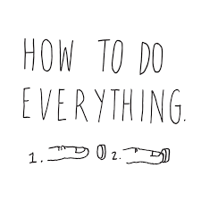
Not a "how-to" guide so much as a "how we did" guide

Slide 5
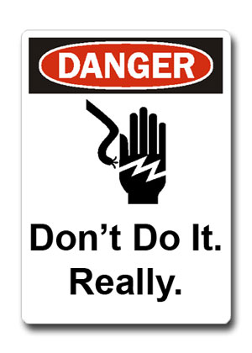
Everything revolves around the idea of "minimum necessary access" and "do it securely or don't do it"

Slide 6
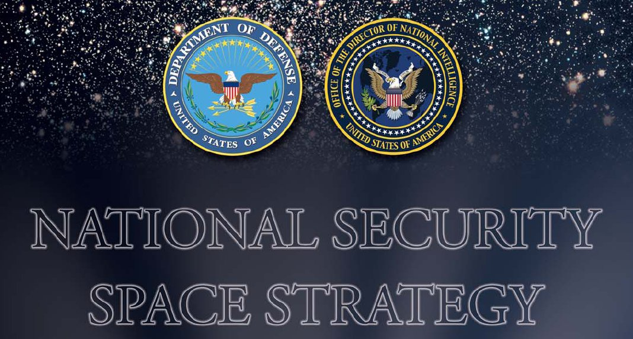
How did we start?
Worked to understand our security space
Knowing how we could manage our infrastructure was key
Understanding our automation tools from the bottom up
Knowing who would help us inside our organization

Slide 7
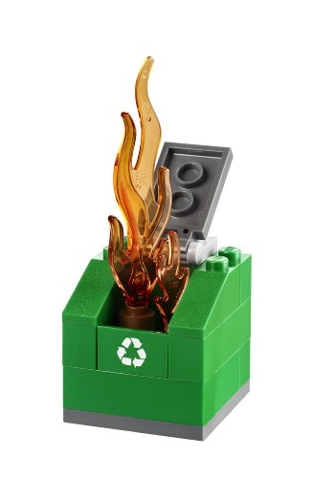
Next steps
We know what we built (image, right)
What we knew we needed: auditable, repeatable process that integrated as fully as possible in to our environment
What could we keep, what could we throw away - and what did we need that was new?

Slide 8

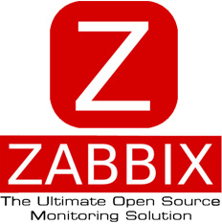


Tools we had
Configuration Management (Chef11)
Monitoring (Zabbix),
Centralised logging (ELK - single node)
Alerting (PagerDuty)

Slide 9
Tools we needed
?!
Better monitoring
Better logging
Infrastructure automation
Better configuration management
Auditing
Code management

Slide 10
Tools we picked
Git for SCM/GitLab for UI & Access Management
Jenkins for CI/CD
Terraform & Packer for IaC
InSpec for infrastructure configuration testing
Chef12 for Configuration Management
ELK - full HA cluster for logging
Sensu for Monitoring
PagerDuty for Alerting

Slide 11
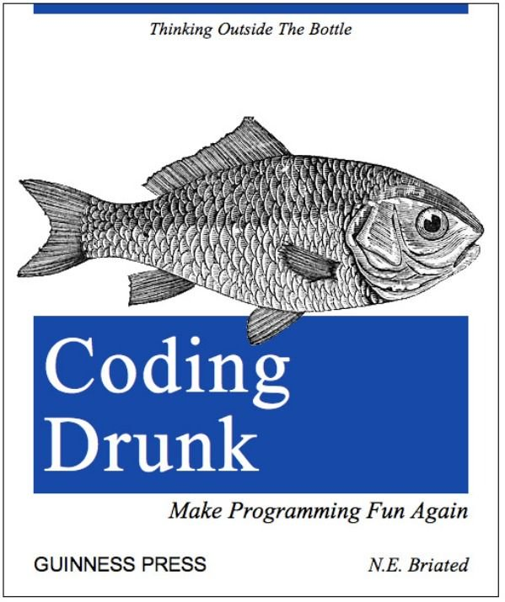
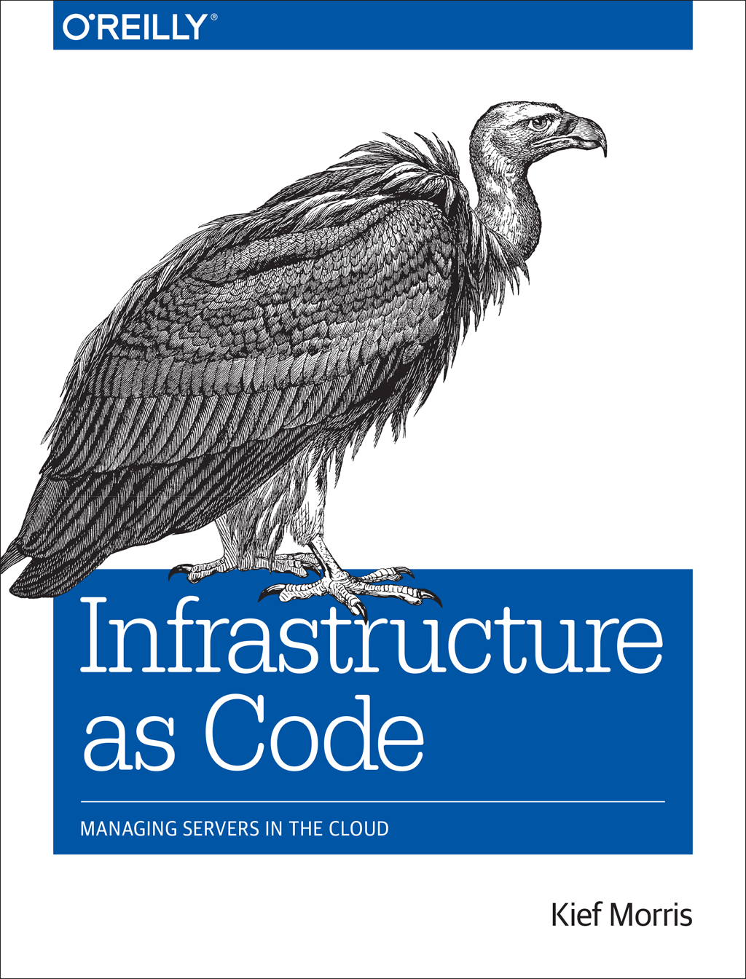
What about the details?
Treat every engineer like a developer
Treat every object in the infrastructure like code

Slide 12




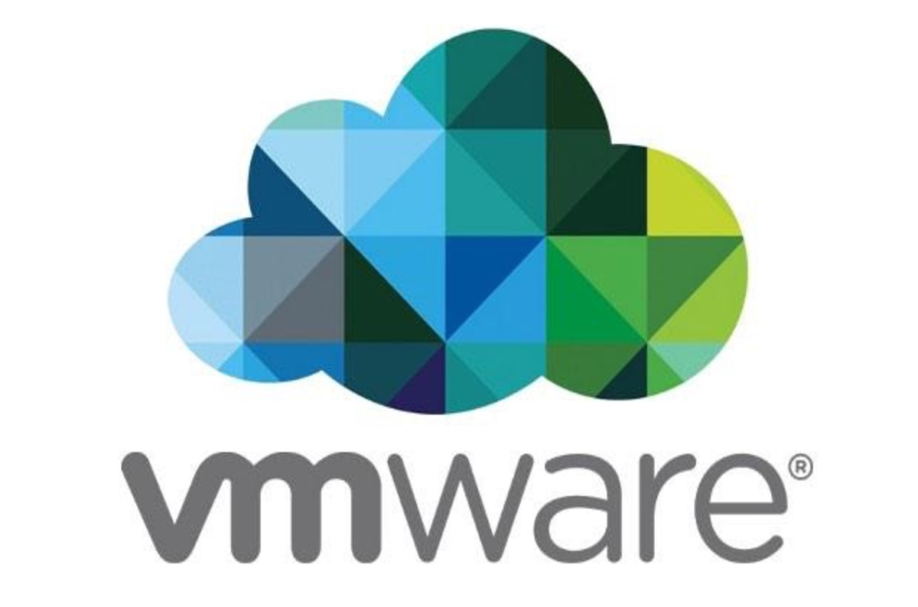
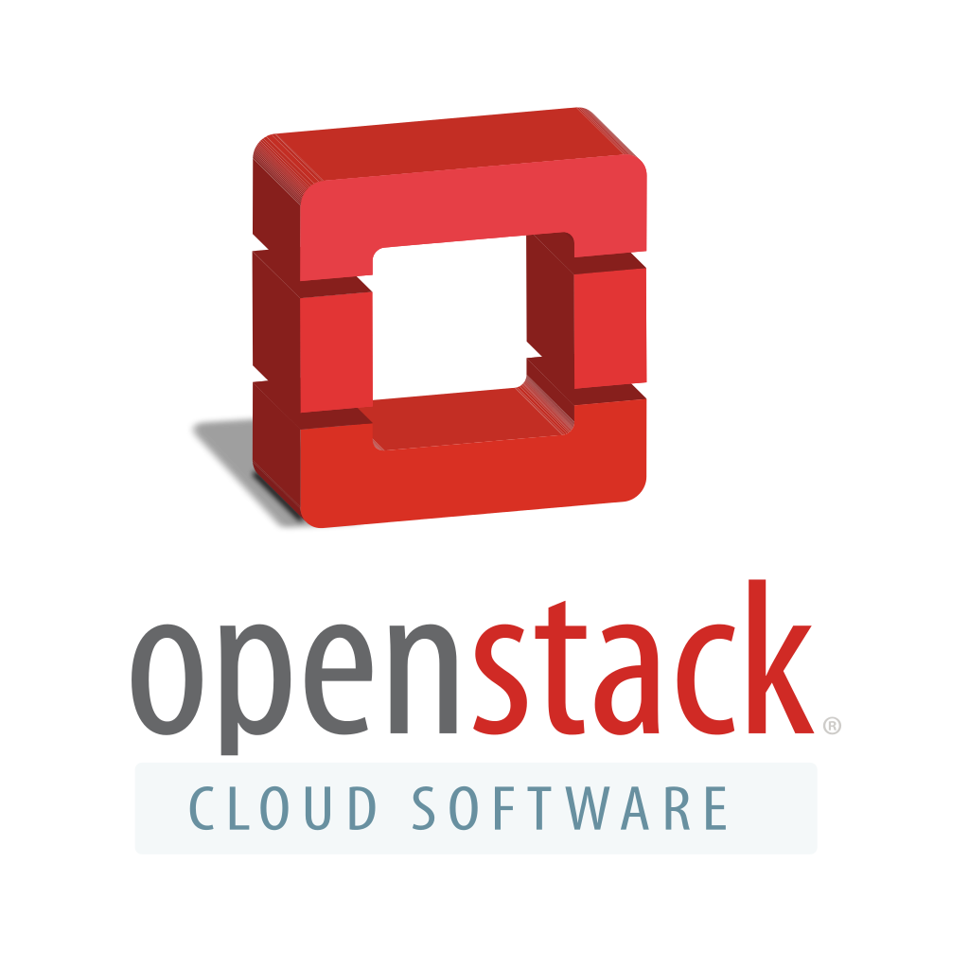
That's great, but how?
Every environment starts with a new group in GitLab and projects initialized with default configurations and build pipelines
Environments are then configured with the appropriate access credentials for the provider
Our providers are legion!
Cloud First class: AWS/Azure
Cloud Second class: Rackspace Cloud, GCE,
On-prem (tertiary): vSphere, OpenStack

Slide 13



Initialisation
Define with Terraform
Created on infrastructure provider
Bootstrapped in to config management
Tested with InSpec for compliance

Slide 14

Configuration
Instances defined in config management (chef12)
Tie instances to monitoring/appropriate checks (sensu)
Log all related data (ELK)

Slide 15
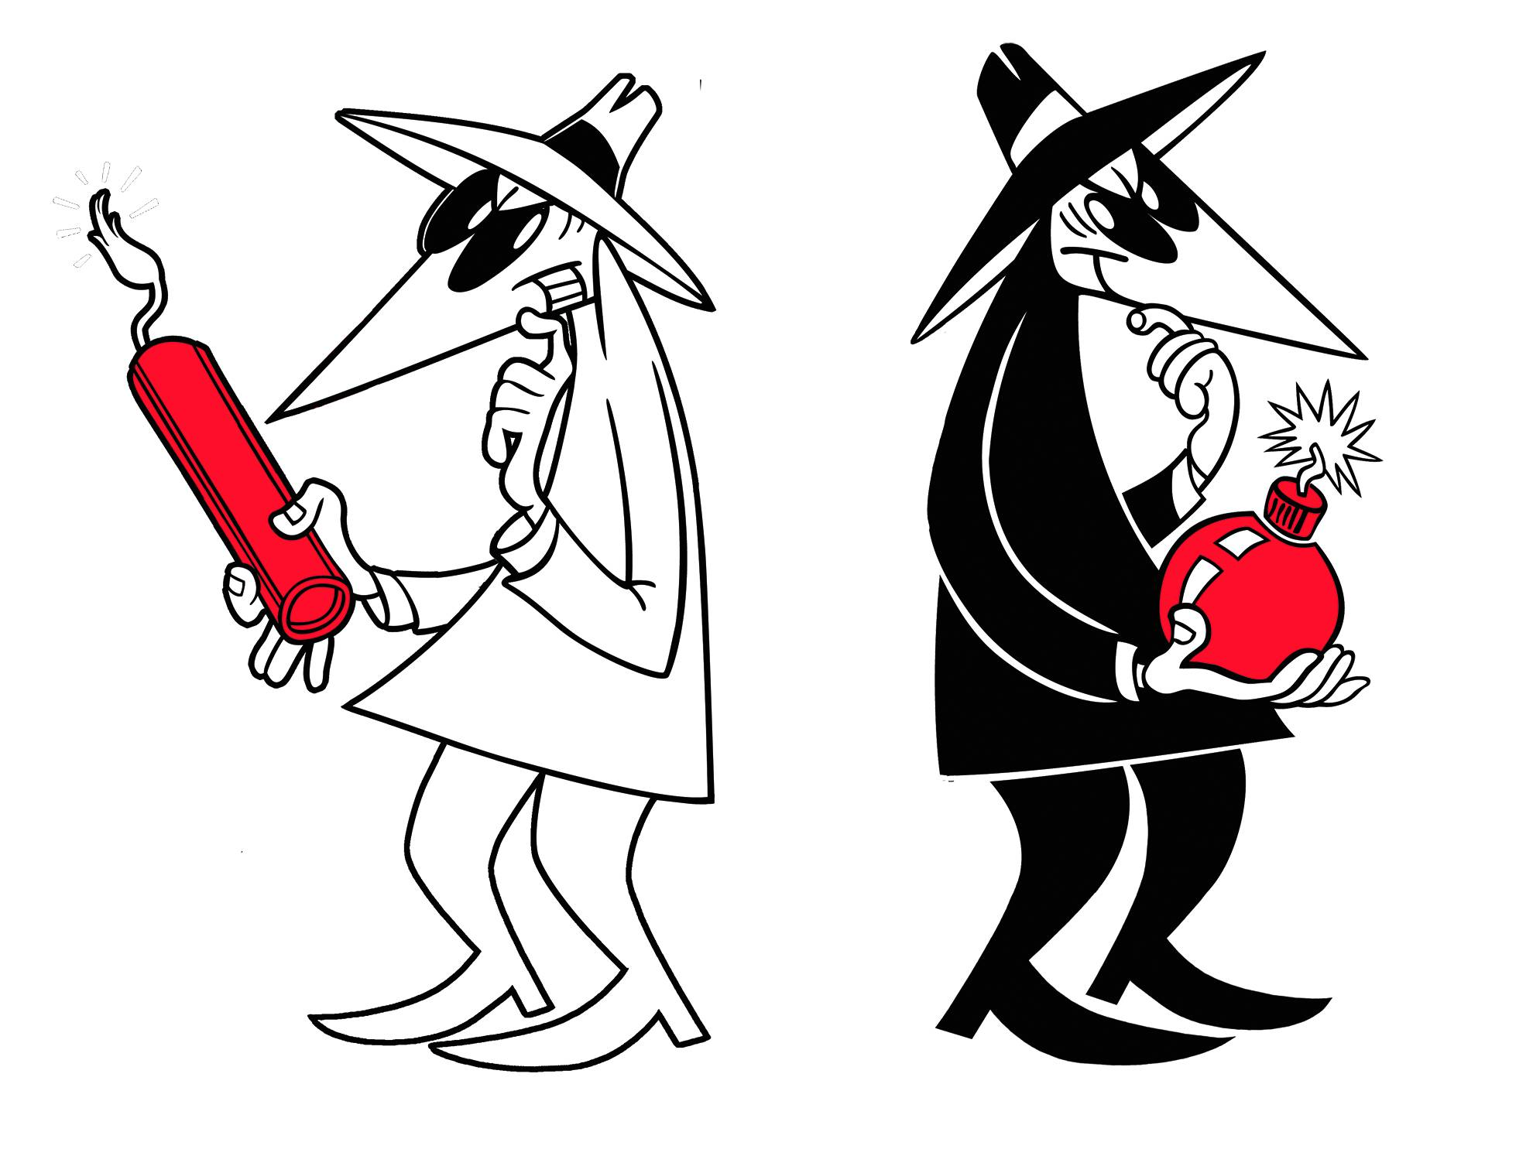
Post-initialisation
All instances are registered for periodic scanning by our security team
Quarterly red teaming

Slide 16
Security
Communications are locked down
https where required,
ssh by default, accounts limited, best practices (key only, no root)
ACLs defined to limit origin traffic
Defined security policy
Client Exceptions require sign off by Security & Client
No Exceptions of internal origin

Slide 17
Security Continued
Minimum necessary access: devs have access to development environments only, non technical personnel have NO access
Infrastructure changes/deployments handled through Jenkins
Code/Applications deployed through whatever build tool the applications team uses (Usually Bamboo or Travis)

Slide 18
What about other security?
Base images built to a hardening standard
Machines are scanned for compliance along the build pipelines
Communication is secured (TLS/SSH/SCP)
Keys are encrypted (GPG) with passwords stored separately
Data objects for configuration management are encrypted

Slide 19
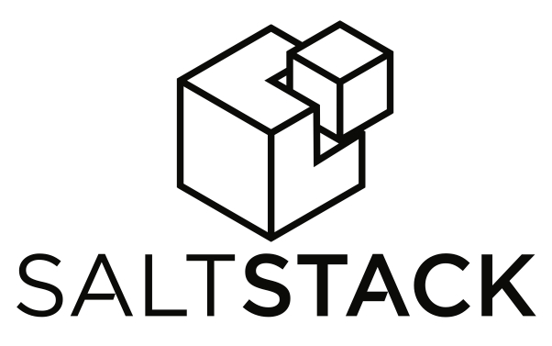




So... why not tool X?
Best internal support (KB, understanding)
Most compatible with other parts of the org
Best trade-offs
Best overall needs for OUR org
You should find what works for you and run with it

Slide 20



Some problems
Lack of client buy-in
Developer demands
Signal v. Noise (Monitoring/Alerting)
Knowledge sharing

Slide 21



THE FUTURE
Better education for both internal orgs and clients
Reduction of noise by tuning our alerts
Better compliance and inspection
Giving back!

Slide 22
Thank you!

